Slide 1

Transfer Learning:
Concepts
Byron Barkhuizen

Slide 2
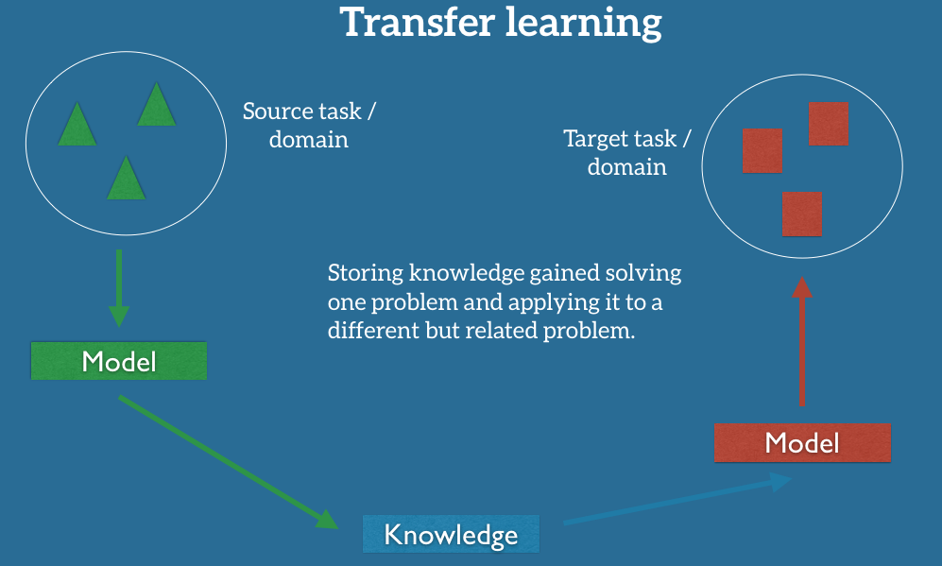

Slide 3
Why is TL needed?
Deep learning models perform very well on a given task, but if the task changes?
A framework that can adapt to changes in the conditions would;
Reduce need for retraining a model
Lower data quantity and/or label requirements
Be generalizable to a large number of new conditions

Slide 4
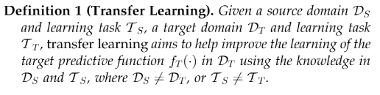
Outline of a problem
Network traffic data in the form of PCAP files
Representation of the PCAP in the model to be used is important;
Task reduces to classification, regression or representation
Representation impacts the features
From the survey of transfer learning [1] we know that transfer learning can be described by the following definition;

Slide 5
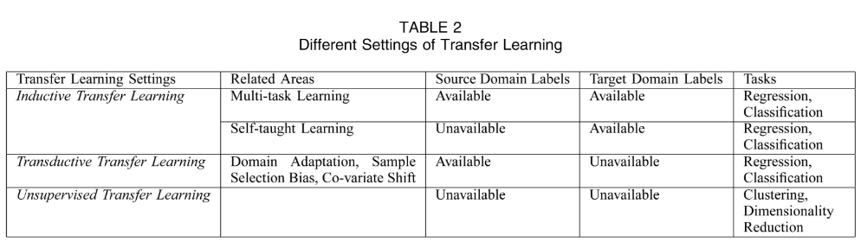
Categorization of the problem
Some techniques/approaches for transfer learning are outlined in the survey

Slide 6
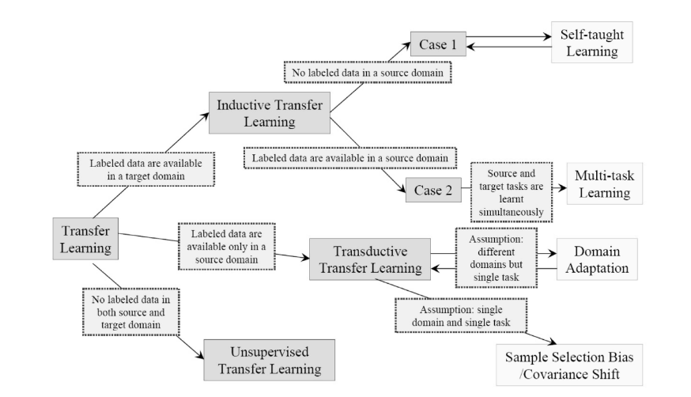

Slide 7
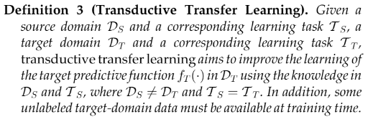
Transductive Transfer Learning
Problem is redefined as:
Covered in the work of mark et. al [1,58] this approach for transfer learning seeks to maximise the use of unlabeled target data where the source and domain tasks are the same.
In the IoT device identification problem setting the task to remain a singular type of device remains the same, however the marginal probability distributions of the features vary between source and domain.

Slide 8
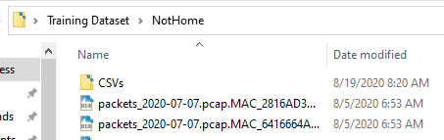
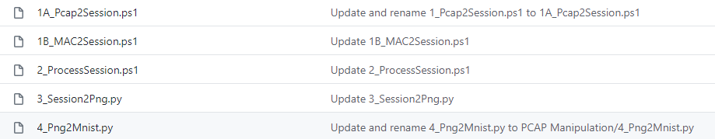
Data Processing
Notes:
https://i.imgur.com/XaBXGcC.png

Slide 9
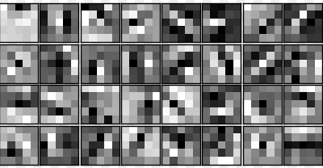
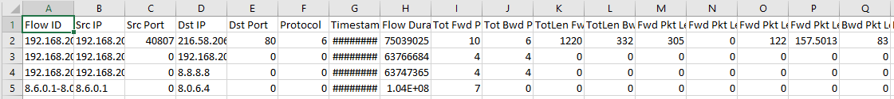
Data Processing
OR
Notes:
https://i.imgur.com/XaBXGcC.png

Slide 10
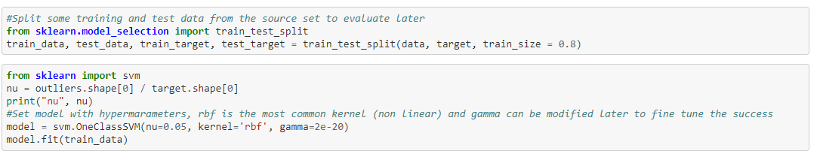
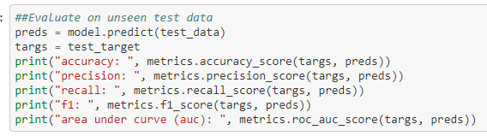

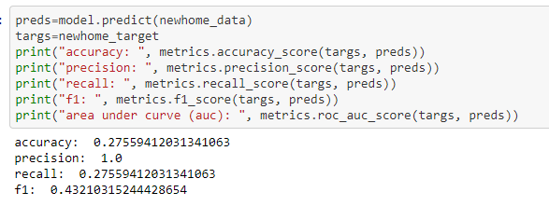
Experiment - OCSVM no TL
at https://github.com/byronbark/IOTProject/blob/master/OCSVM/OCSVM.ipynb

Slide 11
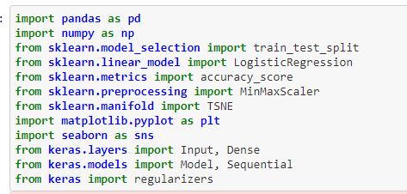
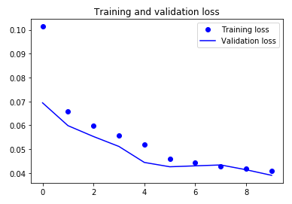
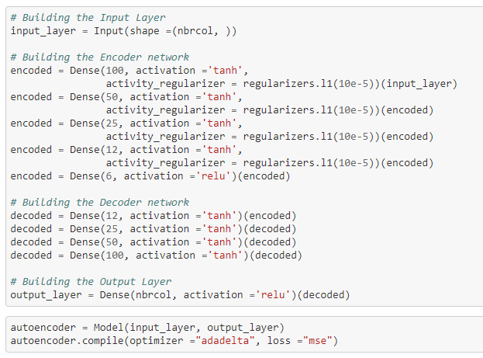
Experiment - Autoencoder
https://github.com/byronbark/IOTProject/tree/master/Autoencoder

Slide 12
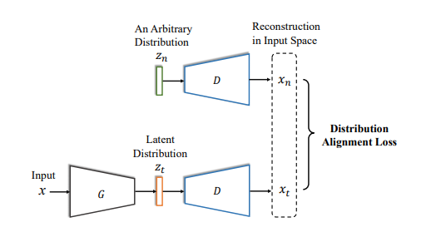
Experiment - Autoencoder for TL
Autoencoder concept for transferring known representations, and adapting them to suit new data requirements (after the domain is being changed)
Consist of a paired encoder and decoder, along with a predictive function
Applies adversarial concepts to learn a representation in the target and source domain concurrently (thus feature alignment)
Similar to reconstruction loss the distribution loss
is minimized -> domain shift is reduced
https://github.com/byronbark/IOTProject/tree/master/TLwithDomainAdaptation

Slide 13
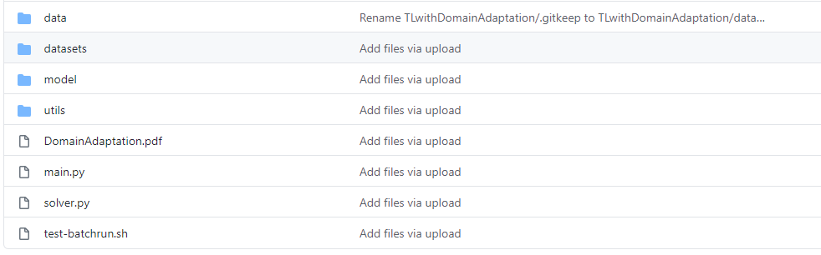
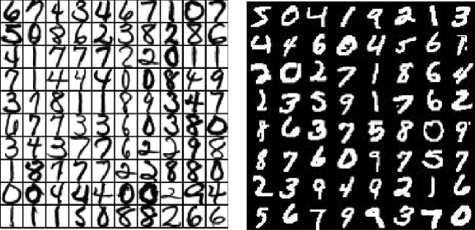
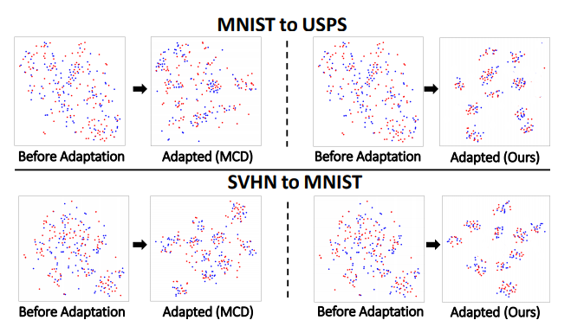
Experiment - Autoencoder for TL
Adapting model parameters to the image data set store as .tgz file from data processing stage.
https://github.com/byronbark/IOTProject/tree/master/TLwithDomainAdaptation

Slide 14
Experiment - Autoencoder for TL
Key Mechanisms;
Paired (share some weights) encoder and decoder with shared learning parameters
A classifier should be available
Feature space of source is discriminative;
Our target should be considered with the source as the definition
Goal is to learn a target feature space that utilizes these discriminative features -> The source feature space is the goal
Feature alignment approach;
Construct a common feature space (Gaussian prior)
Encourage D(T) and D(S) to be close to the gaussian prior
KL-divergence, L-1 distance for evaluating loss
https://github.com/byronbark/IOTProject/tree/master/TLwithDomainAdaptation

Slide 15
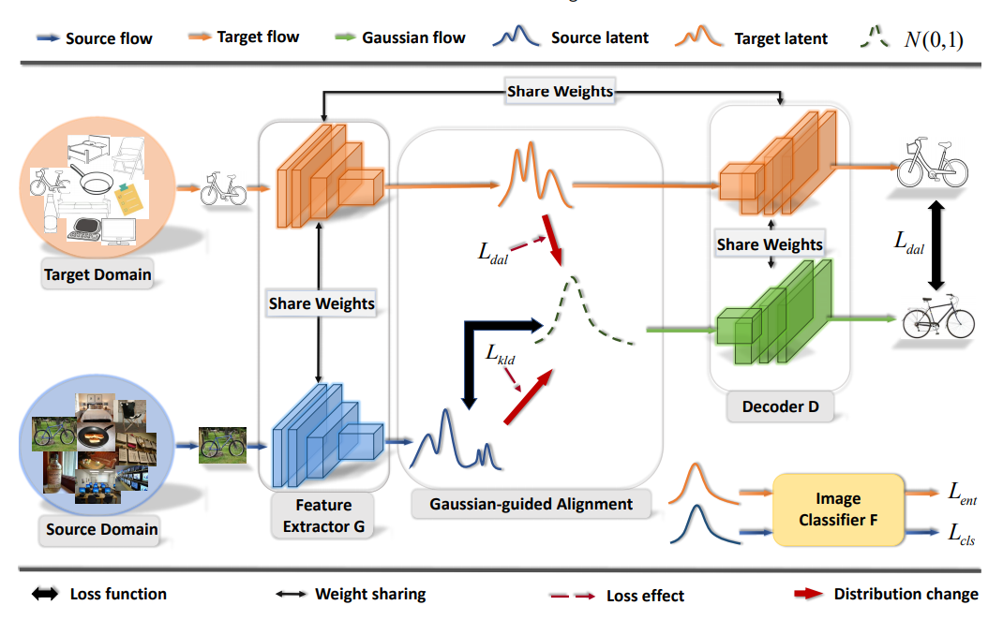

Slide 16
TL Challenges & Outlooks
Adapting DFA framework for more flexible data (options)
Continue experiment for other devices (not just google home)
Tool requirements?
Improvements on the data input

